Slide 1

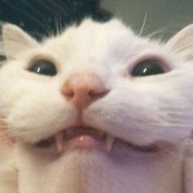
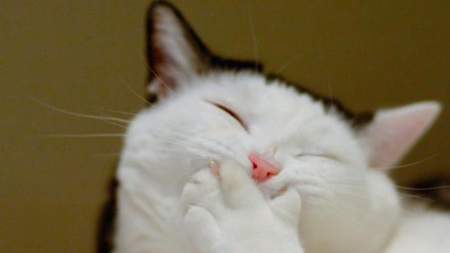
REASONS WHY I DESERVE A STATIONERY BASKET
(AND THE OBJETS I DESERVE)

Slide 2
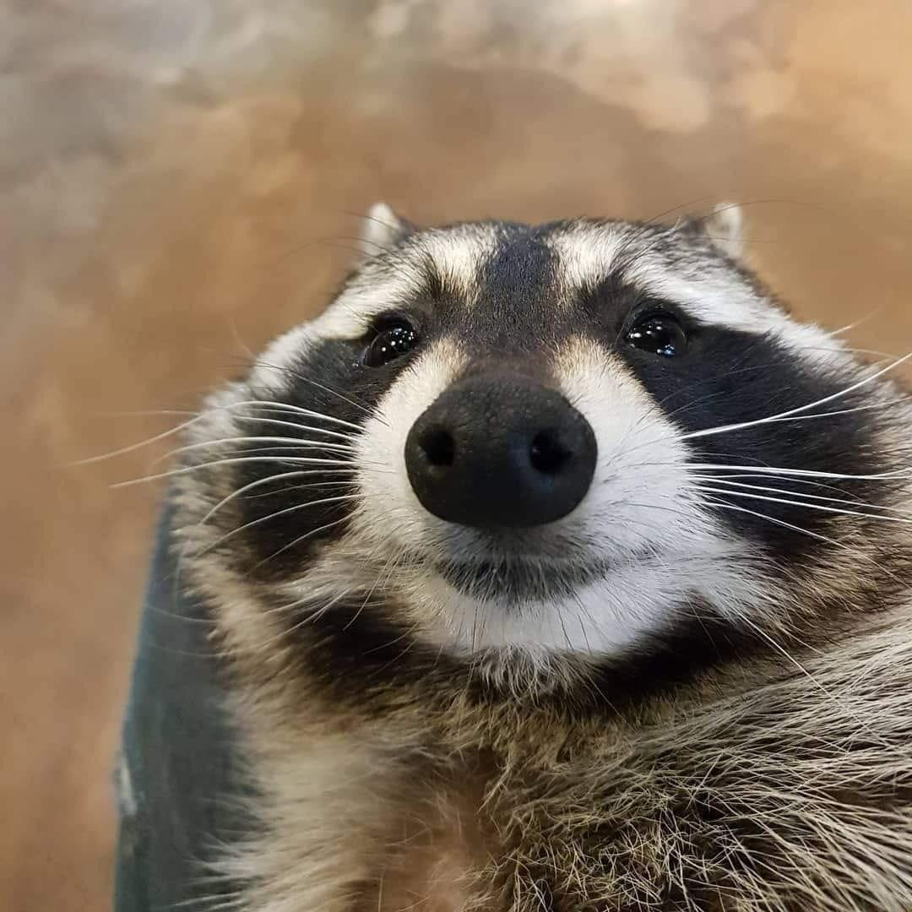
REASONS
IT WOULD MAKE ME EXTREMELY HAPPY
HAPPY WIFE, HAPPY LIFE (I DON’T SAY IT, THE LANDLADY SAID IT)
BECAUSE I DESERVE IT
BECAUSE I’M DOING IT VERY WELL AT FRENCH CLASSES
BECAUSE YES
BECAUSE YOU LOVE ME

Slide 3
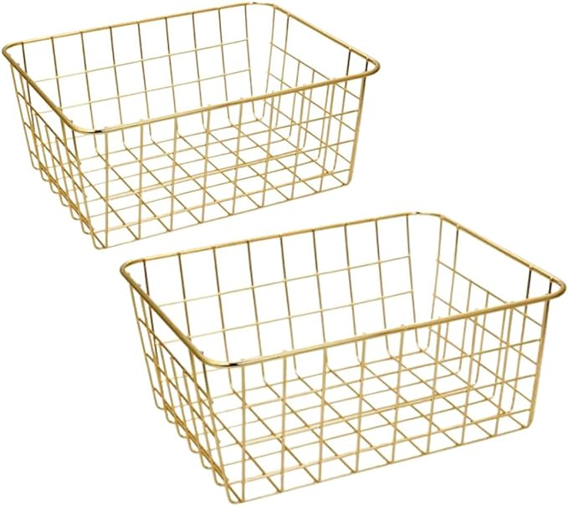
OBJETS I DESERVE
A BASKET (OBVIOUSLY)

Slide 4
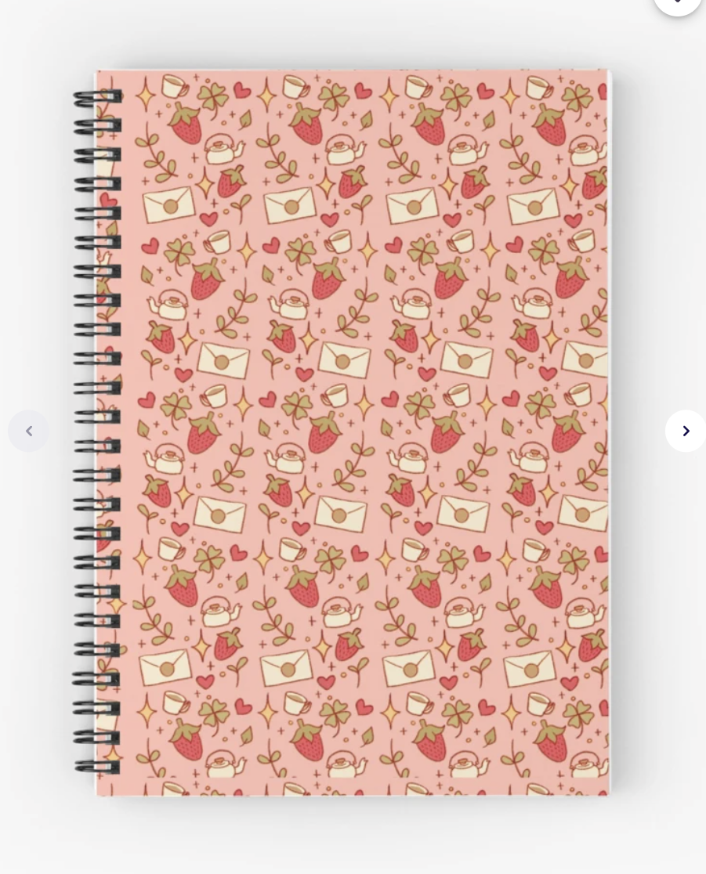
OBJETS I DESERVE
THE STRAWBERRY NOTEBOOK

Slide 5
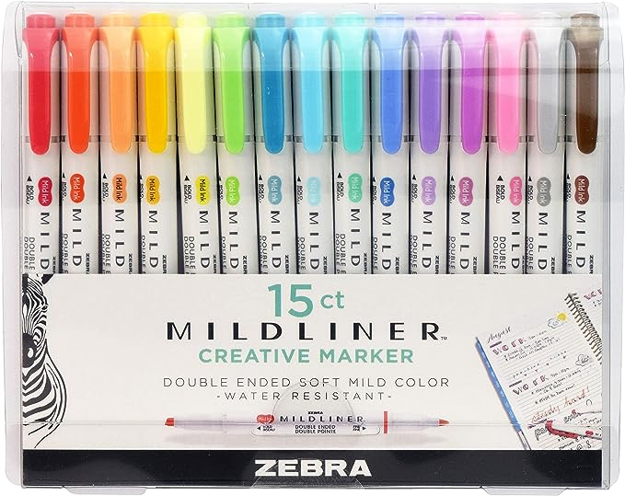
OBJETS I DESERVE
ZEBRA MILDLINERS

Slide 6
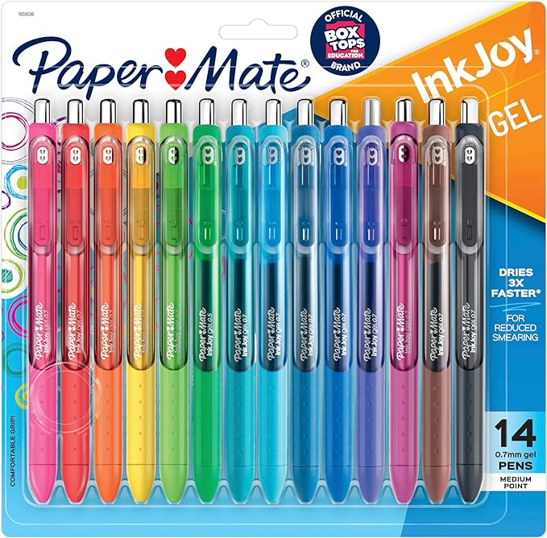
OBJETS I DESERVE
PAPER MATE COLORED PENS

Slide 7
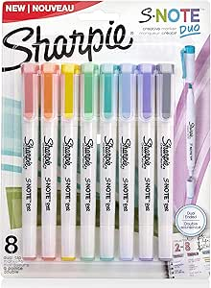
OBJETS I DESERVE
SHARPIES S NOTE DUO

Slide 8
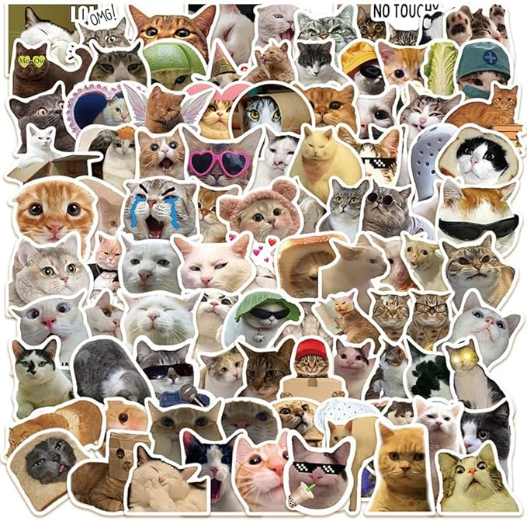
OBJETS I DESERVE
STICKERS (IT DOESN’T MATTER WHICH ONES, JUST CUTE STICKERS)

Slide 9
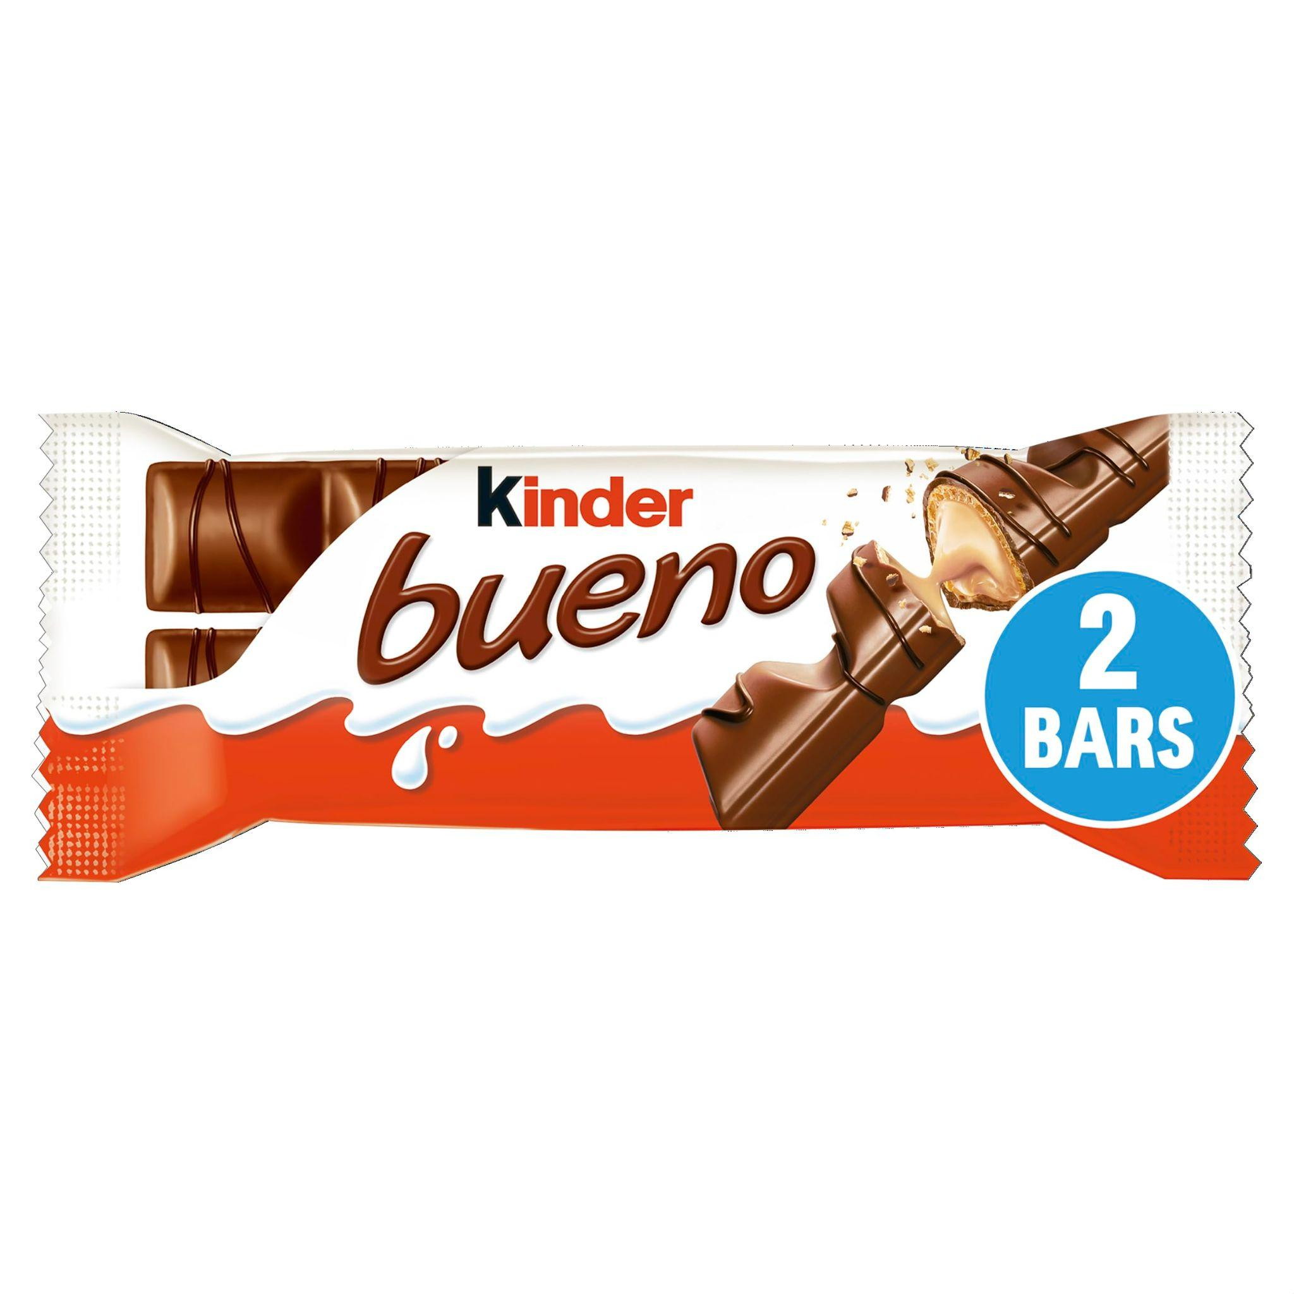
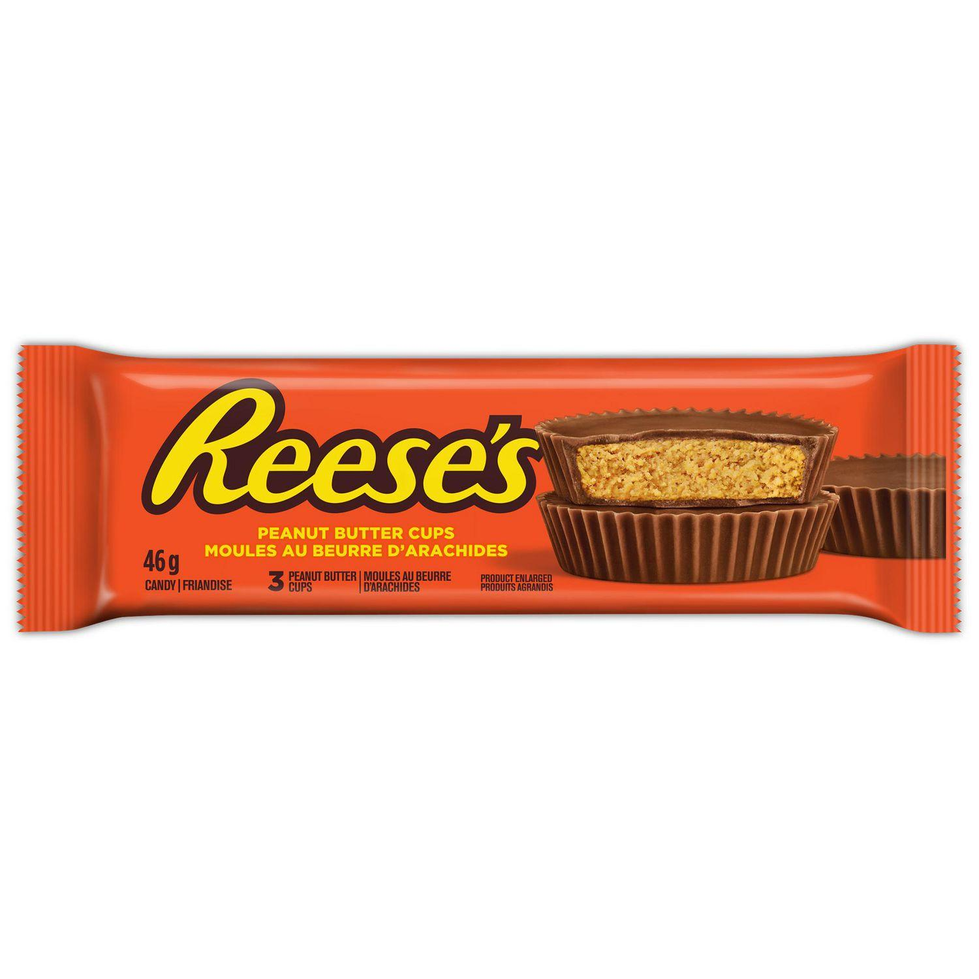
OBJETS I DESERVE
CHOCOLATES (BECAUSE I WILL NEED ENERGY TO USE ALL THAT STUFF)

Slide 10
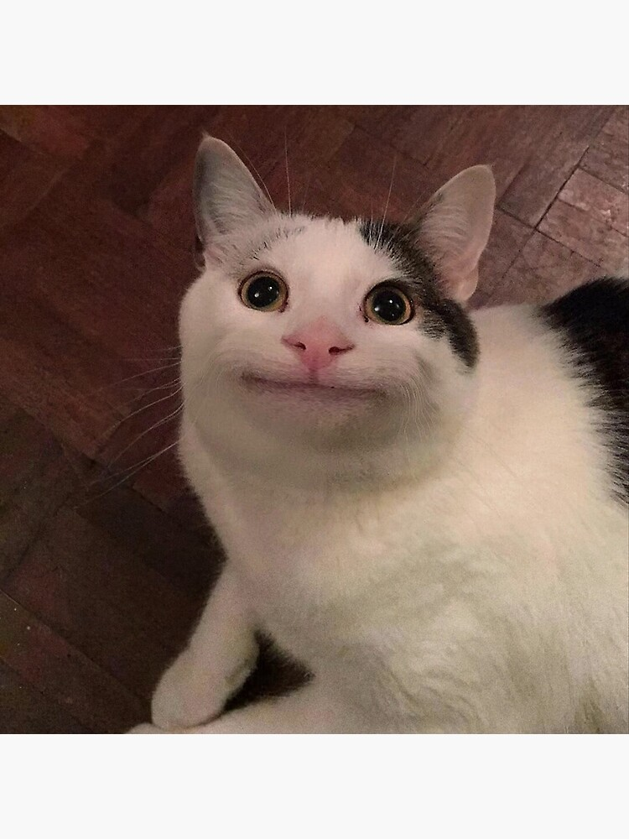
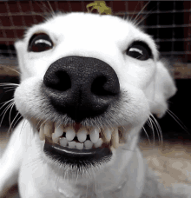
CONCLUSION
I know it’s a lot of stuff so if you get me a stationery basket (which I deserve), it’s okay if it doesn’t have all the stuff I want. It would really make me very happy in these difficult times (french classes). I probably forgot things so if you saw something that you think I would like, it’s welcome to the basket too!

Slide 11
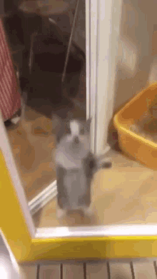
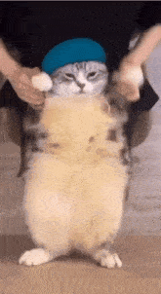
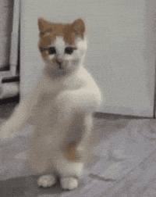
THE END
THANK YOU FOR ATTENDING TO THIS PRESENTATION. WE WISH YOU A BEAUTIFUL DAY!!!!

